Slide 1
Time Scale Modification
Allison Crim

Slide 2
Contents
Time-Scale Modification
Real Life Applications
Methods of Implementation
Overlap-Add
Phase Vocoder
Comparison of Results
Future Work

Slide 3

What is Time Scale Modification
Changing playback speed without changing the signals pitch
Percussive and harmonic signals usually treated differently – different important features
There are many ways to solve this problem depending on input

Slide 4

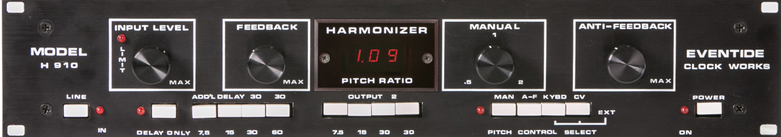
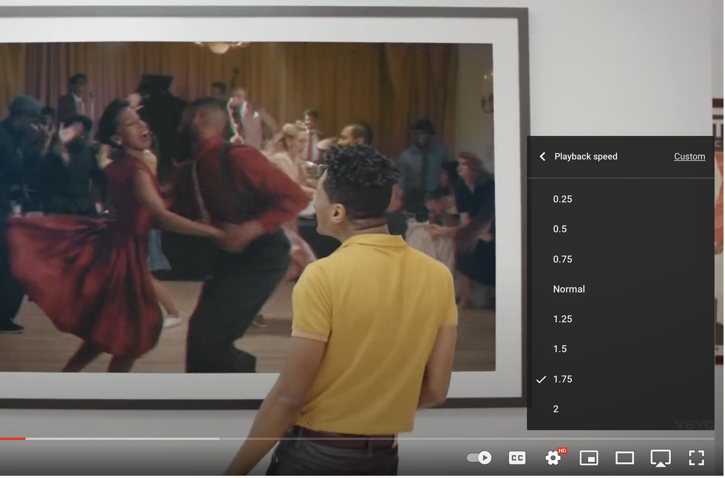

TSM Applications
DJ/Music Production
Video Streaming
Eventide & I Love Lucy

Slide 5
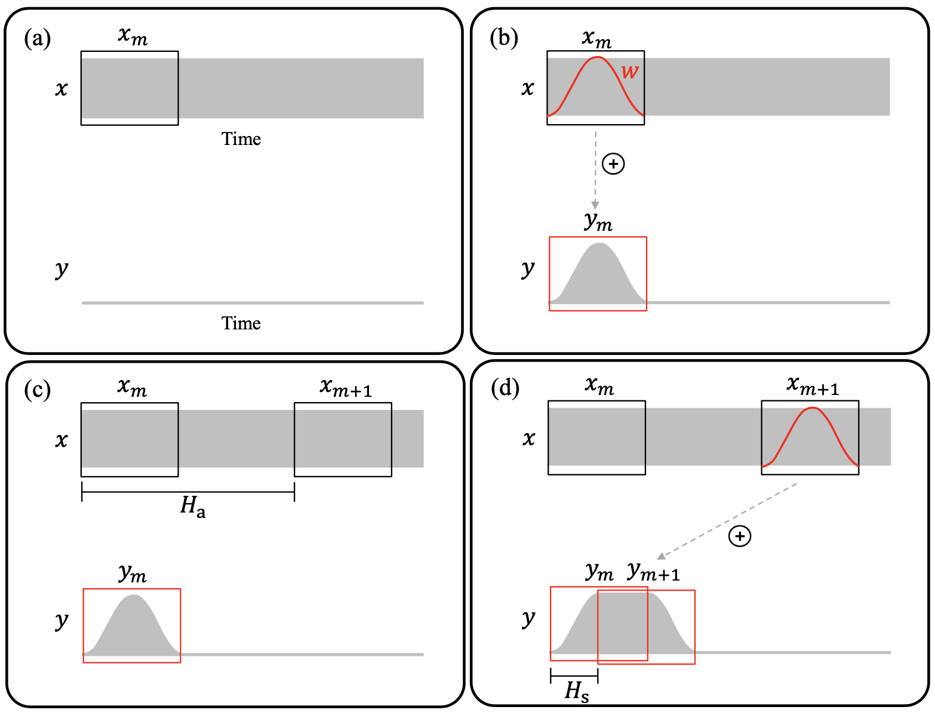
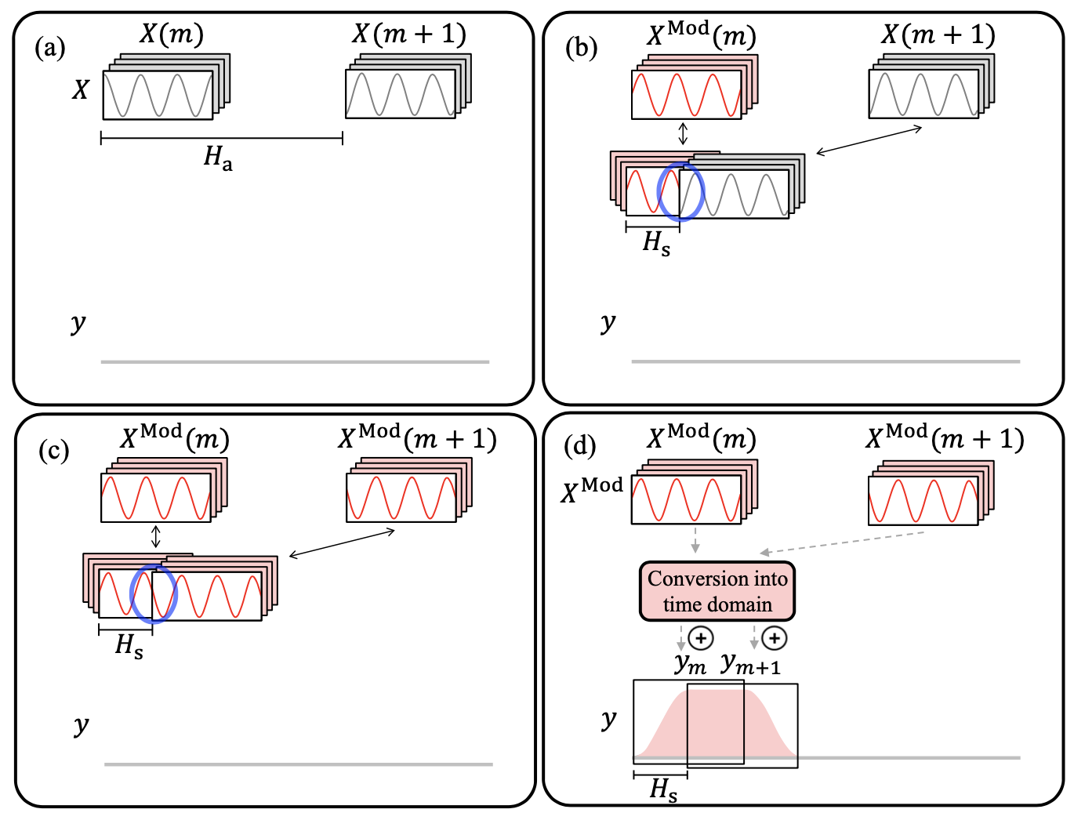
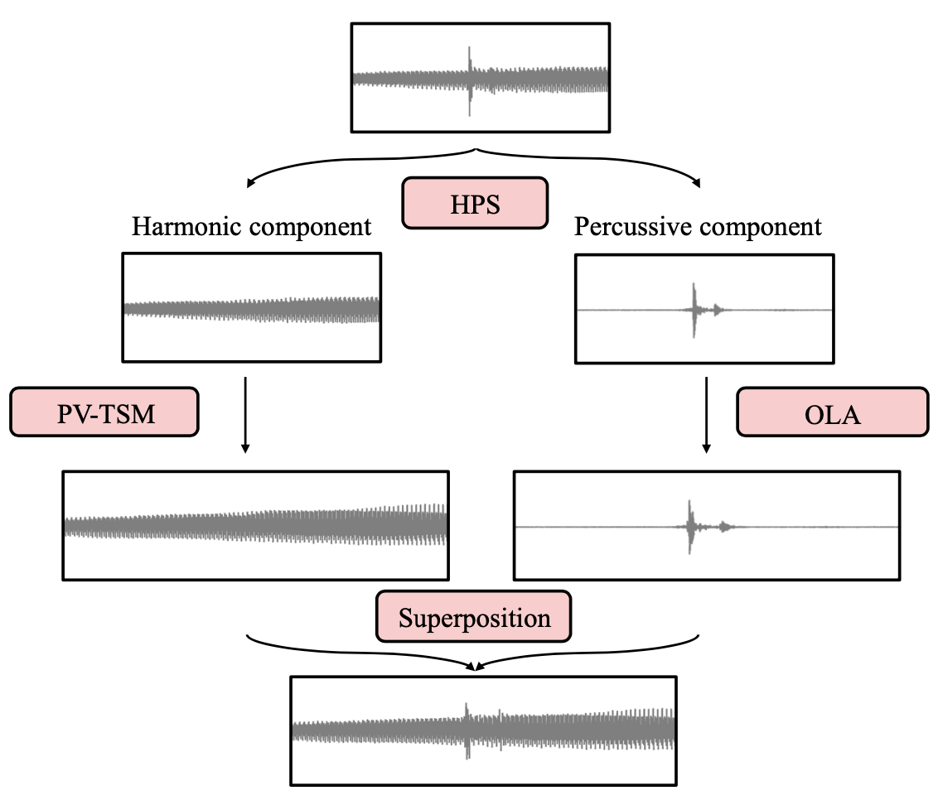
Methods of Implementation
Overlap Add TSM
Phase Vocoder TSM
Harmonic Percussive Separation
Computed in the time domain
Ideal for percussive signals
Introduces warbling to harmonic signals
Computed in the frequency domain
Ideal for harmonic signals
Can add reverberation and cause signals to have ‘less bite’
Computed in both time and frequency domain
Ideal for signals containing both harmonic and percussive signals

Slide 6
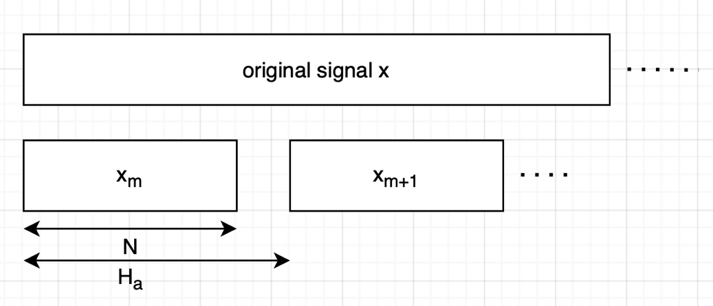
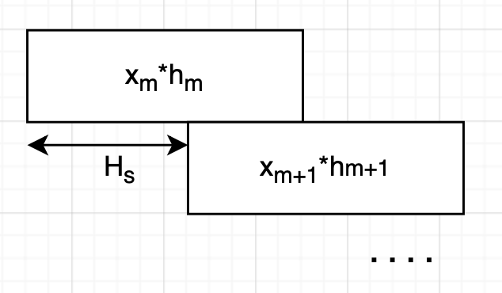
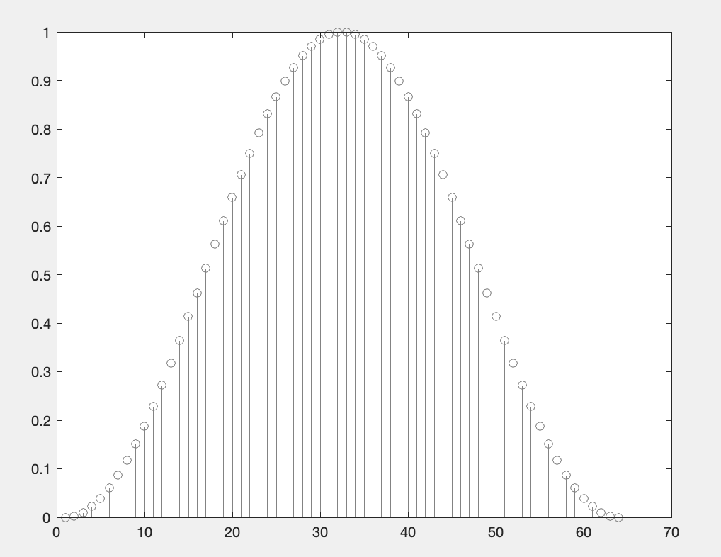
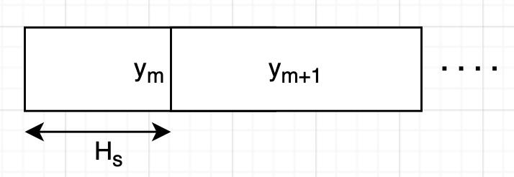
Overlap- Add Based TSM
Step 1
Simple to implement
Signal is stretched by ⍺ which equals H_{s}/H_{a}
Uses Hann window to smooth analysis frame boundaries
Phase jump artifacts create warbling
Step 2
Step 3

Slide 7
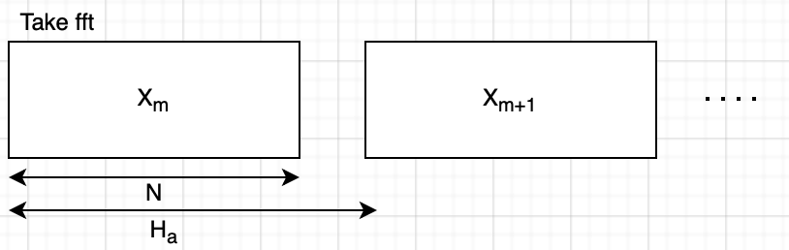
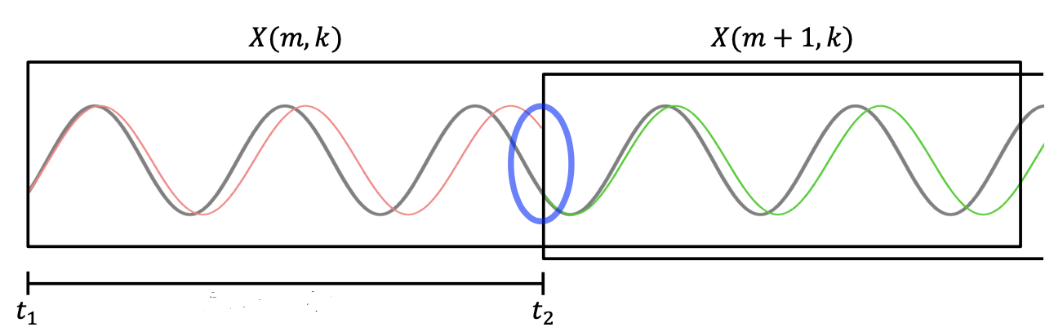
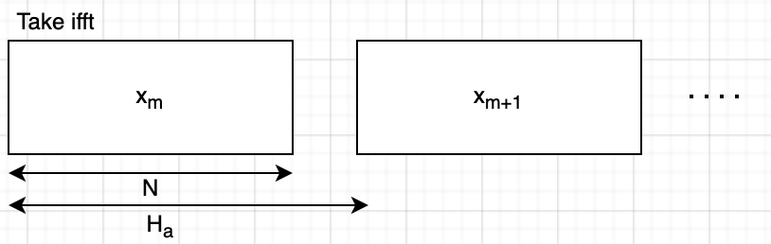
Phase Vocoder Based TSM
Step 1
More complicated to implement
Phase vocoder uses phase information to get estimated frequency
Performs better when analysis frames are bigger
Sidenote – Used Golden and Dolson implementation performed by Dan Ellis at Columbia as a comparison
Step 2
Requires many steps
Step 3
Step 4
Step 5

Slide 8
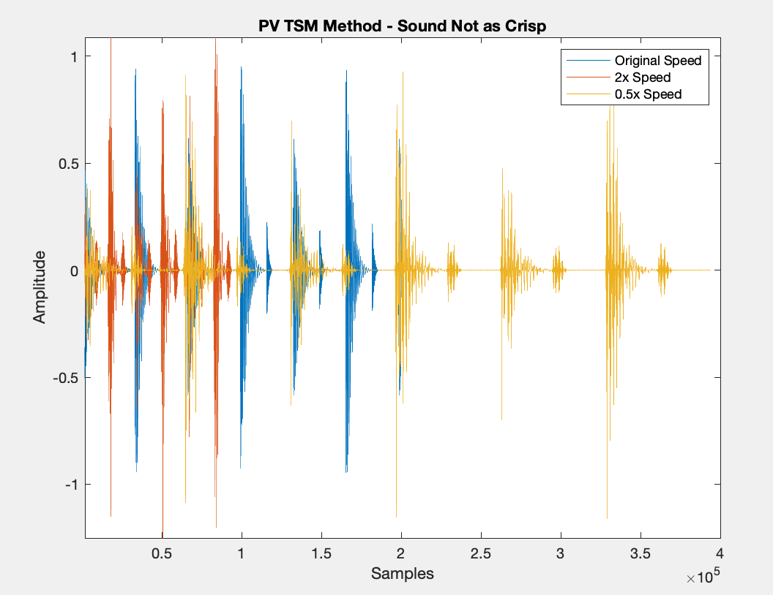
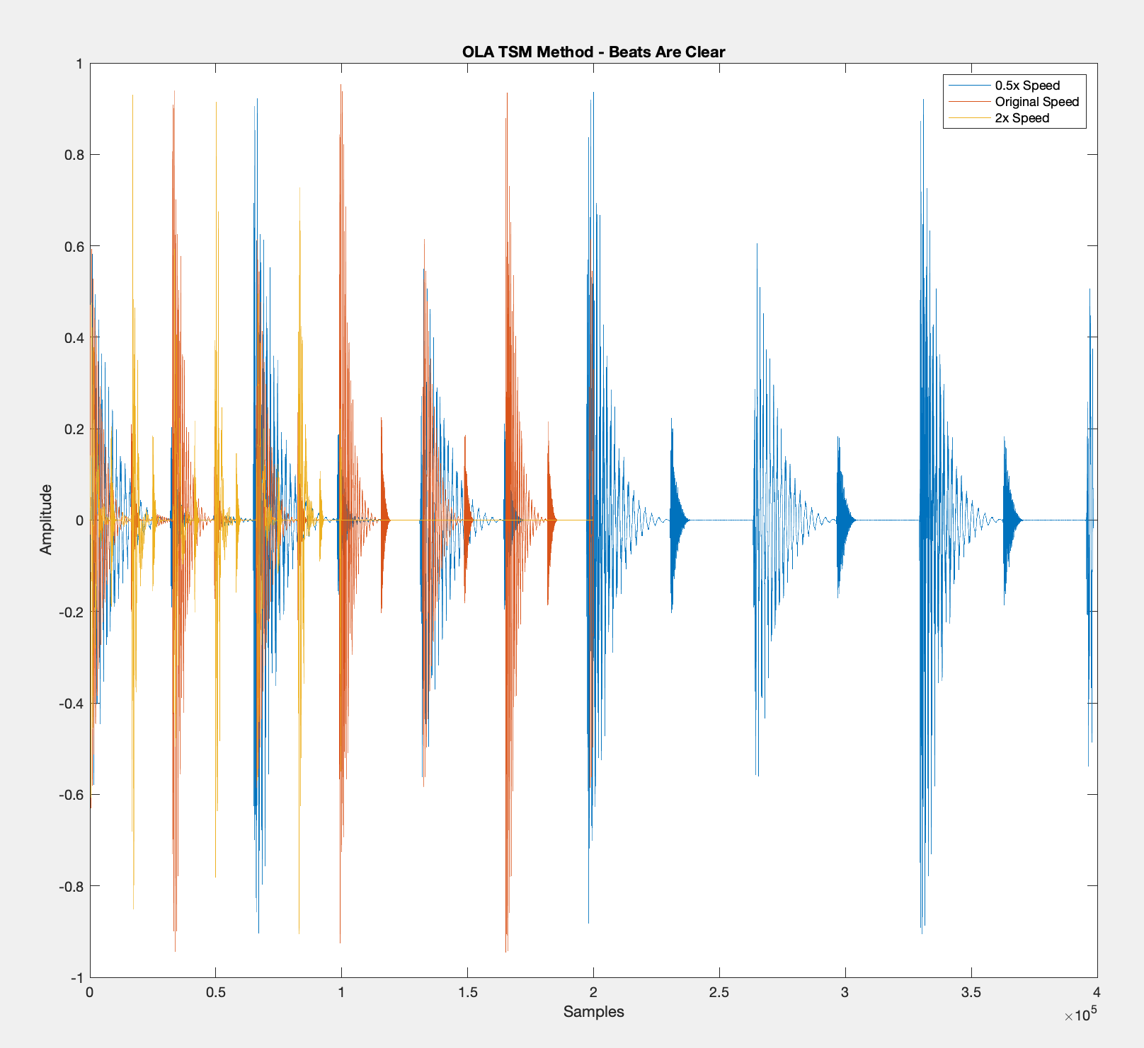
Results – Percussive Input
OLA Percussive Result – Retains Beats
PV Percussive Results – Not Crisp
 | Original Signal | Overlap Add | Phase Vocoder | Columbia PV
Percussive Signal

Slide 9
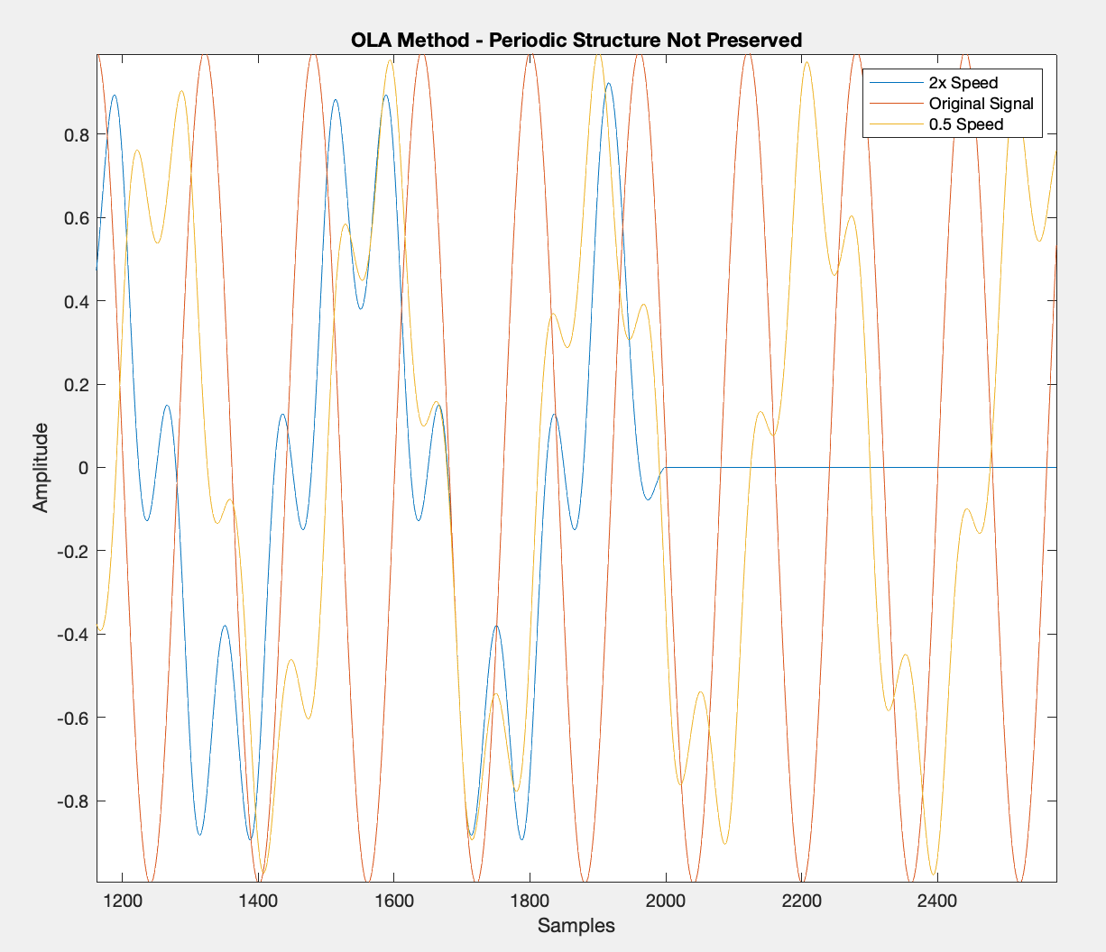
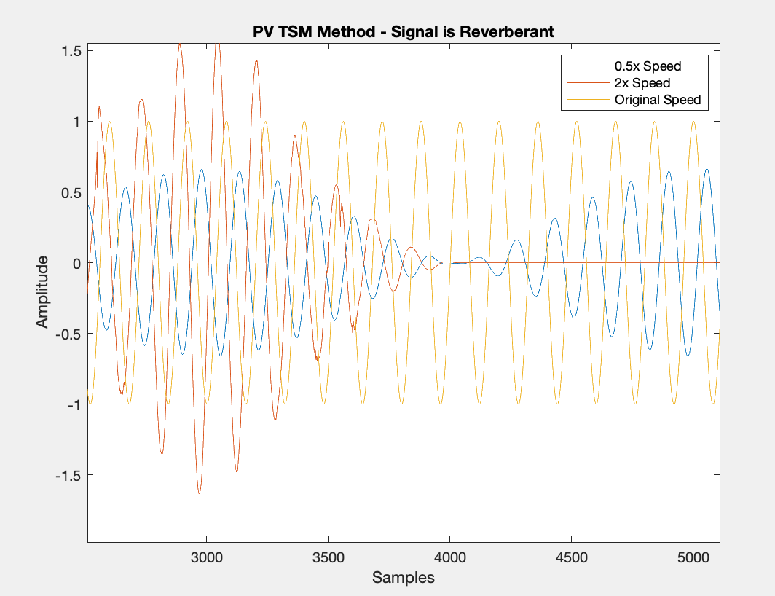
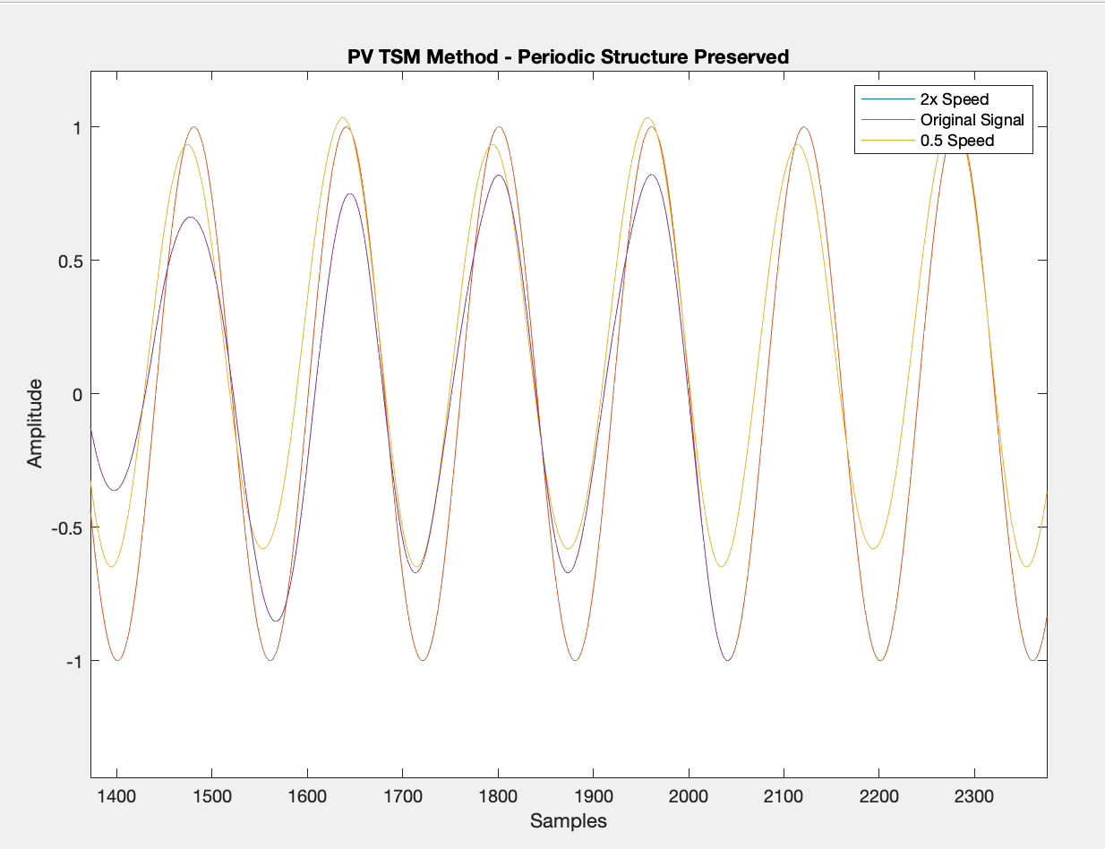
Results – Harmonic Input
 | Original Signal | Overlap Add | Phase Vocoder | Columbia PV
Harmonic Signal

Slide 10
Future Work
Try to minimize reverb in the PV-TSM code
Implement TSM via harmonic-percussive separation and analyze a song with multiple instruments
Implement Non-Linear TSM

Slide 11
References
Driedger, Jonathan, and Meinard Müller. “A Review of Time-Scale Modification of Music Signals.” Applied Sciences, vol. 6, no. 2, 2016, p. 57., https://doi.org/10.3390/app6020057.
Ellis, Dan. A Phase Vocoder in Matlab, https://www.ee.columbia.edu/~dpwe/resources/matlab/pvoc/.
Scarth, Greg. “Untold History: Eventide and the Digital Revolution.” Attack Magazine, 15 June 2018, https://www.attackmagazine.com/features/long-read/untold- history-eventide-and-the-digital-revolution/.
Udo Zolzer. DAFX: Digital Audio Effects. Wiley, 2002.

